Slide 1
Class 1: Introduction and Uninformed Search
Joshua Durso-Finley Course code:
joshua.durso-finley@mail.mcgill.ca

Slide 2
Outline
Search
Uninformed (Today)
Informed
Adversarial
Constraint Satisfaction Problems
Optimization as Search
Probabilistic reasoning
Bayes Nets
Hidden Markov Models
Value Iteration-Policy Iteration
RL
Q-Learning
More if there is time...

Slide 3

Table of Contents
What is a search problem?
Definitions
Search problem formalization
Using search trees to solve search problems
Search algorithms in practice
Depth-First Search
Breadth-First Search
Notes:
‹#›

Slide 4
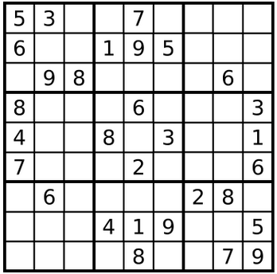
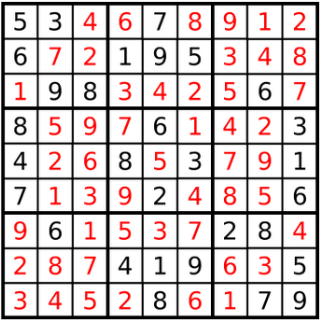
Core of Problem Solving
How can I take actions to reach a goal?
Notes:
‹#›

Slide 5
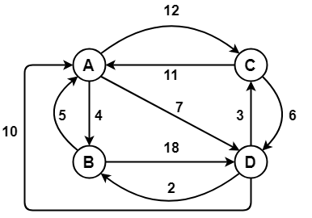
Defining the search problem
The problem exists in a set of states
Starts in an Initial state
There are available actions
Actions change the state
Actions have a cost
We want to find the goal
Notes:
‹#›

Slide 6
Defining the search problem
Set of States S, Set of actions A
Start state s∈S
Transitions a(s)->s’
Goal test g(s)->{0,1}
Cost function C(s,a,s’)
Notes:
‹#›

Slide 7
Generic Search Algorithm
Find a sequence of actions (a₁,...,a_{n}) and states (s₁,...,s_{n})
Such that:
s₀ =s, s_{i}=a_{i}(s_{i-1}) for i=1..n, g(s_{n})=1
While minimizing the cost function:
Σ_{i} C(s_{i-1},a_{i},s_{i})
Notes:
‹#›

Slide 8
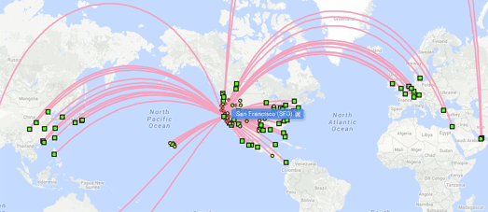
Example
States: Airports, times
Start State: PET airport at 7pm
Actions: Take an available flight
Goal: reach Moscow within 24 hours
Cost function: Money/time
Notes:
‹#›

Slide 9
How would we solve this problem?
Start State: PET airport at 7pm.
Goal: Reach Moscow within 24 hours with the smallest cost
Build up a search tree with airports and times as nodes
Notes:
‹#›

Slide 10
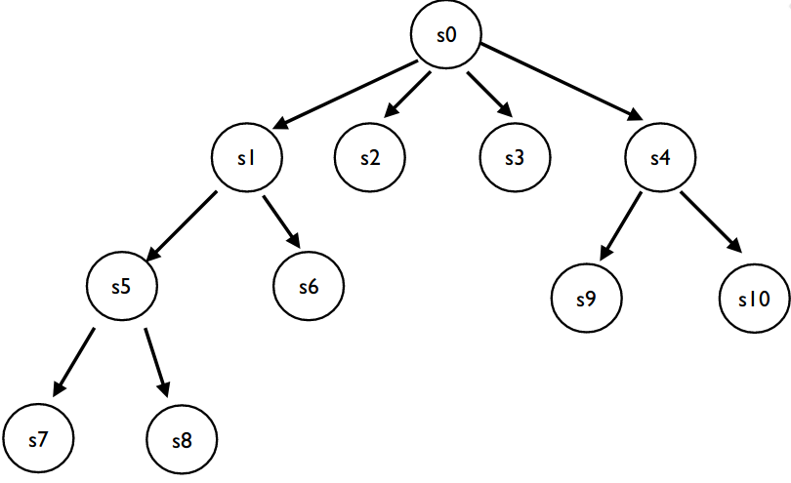
The Search Tree
A search tree has each state as a node
Each action moves to a child of the current state
We want to find a solution by looking through the tree
Notes:
‹#›

Slide 11
Important Quantities of Trees
Branching Factor b i.e How wide are the branches
Depth
Depth of minimum solution m
Maximum Depth d
Number of states/nodes: O(b^{d})
Notes:
‹#›

Slide 12
Search in General
Keep track of visited states
Take states from a set of unvisited states until the goal state is found
How we take states from the set of unvisited states determines the algorithm
Breadth first search: Using a Queue
Depth first search: Using a Stack
A*: Using a heap
Notes:
‹#›

Slide 13
How to pick unvisited nodes?
Uniformed strategies:
Explore the deepest node(DFS)
Explore closest node(BFS)
Only consider reachable nodes
Keep track of those with a frontier (set of unvisited, but reachable nodes)
Notes:
‹#›

Slide 14
Depth first search (Using a Stack)
Expand deepest state
Start State: s₀
Add children to the set of unexplored nodes
Set of visited {S₀}
Set of unexplored {S₁,S₄}
s₀
s₁
s₄
Notes:
‹#›

Slide 15
Depth first search
Expand deepest state: s1
Set of visited {s_{0,}s₁}
Set of unexplored {s₂,s₄}
s₀
s₁
s₄
s₂
Notes:
‹#›

Slide 16
Depth first search
Expand deepest state: s₂
Set of visited {s_{0,}s_{1,}s₂}
Set of unexplored {s₃,s₄}
s₀
s₁
s₄
s₂
s₃
Notes:
‹#›

Slide 17
Depth first search
Expand deepest state: s₃
Set of visited {s_{0,}s_{1,}s_{2,}s₃}
Set of unexplored {S₄}
s₀
s₁
s₄
s₂
s₃
Notes:
‹#›

Slide 18
Depth first search
Expand deepest state: s₄
Set of visited {s_{0,}s_{1,}s_{2,}s₃,s₄}
Set of unexplored {s₅,s₆}
s₀
s₁
s₄
s₂
s₅
s₆
s₃
Notes:
‹#›

Slide 19
Depth first search
Expand deepest state: s₅
Set of visited {s_{0,}s_{1,}s_{2,}s₃,s_{4,}s₅}
Set of unexplored {s₆}
s₀
s₁
s₄
s₂
s₅
s₆
s₃
Notes:
‹#›

Slide 20
Depth first search
Expand deepest state: s₆
Set of visited {s_{0,}s_{1,}s_{2,}s₃,s_{4,}s_{5,}s₆}
Set of unexplored {}
s₀
s₁
s₄
s₂
s₅
s₆
s₃
Notes:
‹#›

Slide 21
Depth first search
Recap of DFS algorithm:
1. Expanded deepest state
2. Added children to the set of unexplored nodes
3. Selected next node to expand
How do we evaluate search algorithms?
1. Space complexity: O(b*d)
2. Time complexity: O(b^{d})
3. Completeness (Will find a solution if one exists)?:
For finite trees
4. Optimal (Will find a solution at minimum depth)?:
No!
s₀
s₁
s₄
s₂
s₅
s₆
s₃
Notes:
‹#›

Slide 22
Breadth first search
Expand closest state
Start State: s₀
Add children to the set of unexplored nodes
Visited {S₀}
Unexplored {S₁,S₄}
s₀
s₁
s₄
Notes:
‹#›

Slide 23
Breadth first search
Expand closest state: s1
Visited {s_{0,}s₁}
Unexplored {s₂,s₄}
s₀
s₁
s₄
s₂
Notes:
‹#›

Slide 24
Breadth first search
Expand closest state: s₄
Visited {s_{0,}s_{1,}s₄}
Unexplored {s_{2,}s_{5,}s₆}
s₀
s₁
s₄
s₂
s₅
s₆
Notes:
‹#›

Slide 25
Breadth first search
Expand closest state: s₂
Visited {s_{0,}s_{1,}s_{4,}s₂}
Unexplored {s_{3,}s_{5,}s₆}
s₀
s₁
s₄
s₂
s₅
s₆
s₃
Notes:
‹#›

Slide 26
Breadth first search
Expand closest state: s₅
Visited {s_{0,}s_{1,}s_{4,}s_{2,}s₅}
Unexplored {s₃,s₆}
s₀
s₁
s₄
s₂
s₅
s₆
s₃
Notes:
‹#›

Slide 27
Breadth first search
Expand closest state: s₆
Visited {s_{0,}s_{1,}s_{4,}s_{2,}s_{5,}s₆}
Unexplored {s₃}
s₀
s₁
s₄
s₂
s₅
s₆
s₃
Notes:
‹#›

Slide 28
Breadth first search
Expand closest state: s₃
Visited {s_{0,}s_{1,}s_{4,}s_{2,}s_{5,}s_{6,}s₃}
Unexplored {}
s₀
s₁
s₄
s₂
s₅
s₆
s₃
Notes:
‹#›

Slide 29
Breadth first search
Recap of BFS algorithm:
1. Expanded closest state
2. Added children to the set of unexplored nodes
3. Selected next node to expand
How do we evaluate search algorithms?
1. Space complexity: O(b^m)
2. Time complexity: O(b^m)
3. Completeness (Will find a solution if one exists)?:
Yes
4. Optimal (Will find a solution at minimum depth)?:
Yes
s₀
s₁
s₄
s₂
s₅
s₆
s₃
Notes:
‹#›

Slide 30
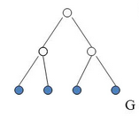
Breadth first search (Space)
Space complexity: O(b^{m})
At most we need to store the children of the level of the solution
All the nodes are stored at the deepest level
Notes:
‹#›

Slide 31
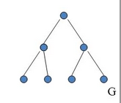
Breadth first search (Time)
Time complexity: O(b^{m})
At most we need to explore every single node in the tree up to the solution depth which has O(b^{m}) nodes
Notes:
‹#›

Slide 32
Recap of Basic searches
The goal of uninformed search is to find a goal node without any information about transitions or states.
Depth-First Search is implemented with a stack, has O(b^d) time complexity, O(b*d) space complexity
Breadth-First Search is implemented with a queue, has O(b^m) time complexity, O(b^m) space complexity.
Notes:
‹#›

Slide 33
Activity
Fill out assignment 1
Notes:
‹#›

Slide 34
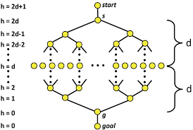
Bidirectional Search
Notes:
‹#›

Slide 35
Bidirectional Search
What do we need that we didn’t need before?
Notes:
‹#›

Slide 36
Bidirectional Search
What is the number of nodes we need to visit?
2*(b^(d/2))
When do we stop?
When the frontiers intersect
Is the solution optimal?
The solution may not be optimal there could be shortcuts
Notes:
‹#›

Slide 37
Iterative Deepening Search
DFS: great memory cost but possibility of suboptimal solution
BFS: Optimal solution but high memory cost O(b^m+1)
If DFS was optimal and complete it would be great
Can we get the best of both?
Notes:
‹#›

Slide 38
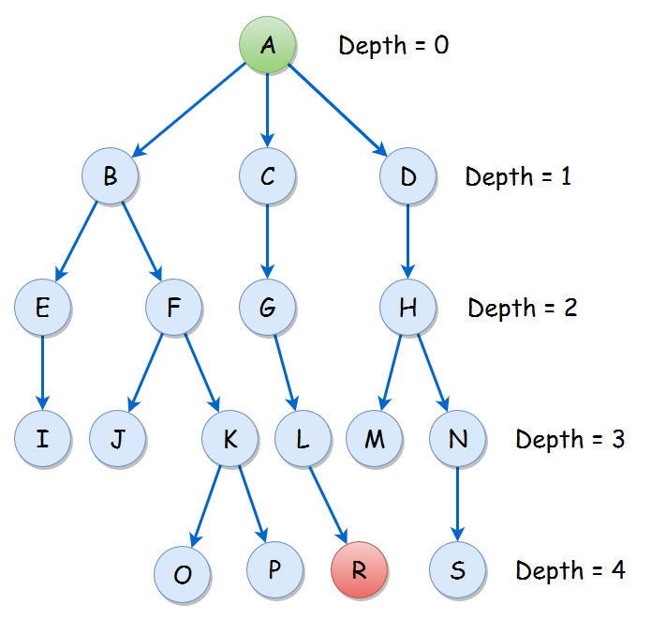
Iterative Deepening Search
Run DFS up to a certain depth and then increment the depth by 1.
Start at z=1
Increment by 1 each time
Notes:
‹#›

Slide 39
Iterative Deepening Search
Notes:
‹#›

Slide 40
Iterative Deepening Search
Why does this give any benefits?
Duplicates work
Opens more nodes than BFS
#of Nodes =Σ b^i * (m-i +1)
b^i= Nodes at level i
(m-i+1) times visited
Notes:
‹#›

Slide 41
Iterative Deepening Search
Optimal
DFS memory requirement
Complete
Not much worse than BFS(time)
Notes:
‹#›

Slide 42
Iterative Deepening Search
The insight is that most of the nodes are on the last level
Notes:
‹#›

Slide 43
Iterative Deepening Search
Code IDS in the colab notebook
https://movingai.com/dfid.html
Notes:
‹#›

